Slide 1
CAMBRIDGE HOSPITAL
Your Most Trusted
Health Partner

Slide 2
INTRODUCTION
Cambridge Hospital is a leading healthcare facility known for its state-of-the-art medical technology and expert medical staff. Established in 1985, it provides exceptional care across various specialties with a focus on compassion and innovation.
The hospital is equipped with advanced diagnostic and therapeutic equipment, ensuring precise and effective treatment. Its team of highly skilled doctors, nurses, and support staff work collaboratively to address the unique needs of each patient.

Slide 3
INTRODUCTION
Cambridge Hospital is a leading healthcare facility known for its state-of-the-art medical technology and expert medical staff. Established in 1985, it provides exceptional care across various specialties with a focus on compassion and innovation.
The hospital is equipped with advanced diagnostic and therapeutic equipment, ensuring precise and effective treatment. Its team of highly skilled doctors, nurses, and support staff work collaboratively to address the unique needs of each patient.

Slide 4
PROBLEM STATEMENT
The goal is to create a user-friendly website with easy navigation, a visually appealing design, and an organized structure. Key requirements include: Home Page: Must include a description of the hospital, its founder, and significant achievements. It should also have clear navigation links. Key Sections: The website should feature sections like "About Us," "Departments," "Facilities," "Services," "Centers," "Contact Us," "Query," "Feedback," and "Reviews. "Content" and Links: Each section should provide detailed information, be hyperlinked properly, and incorporate images where necessary. Contact Page: Should prominently display the address of all hospital locations. Department Details: Information on "Helpdesk," "Registration," "Doctor Schedule," "Billing and Accounts," etc. Facilities: Includes "Rooms," "ICU," "Medical Facilities," and other hospital amenities. Services: Covers general services, health checkups, specialties, and more. Centers: Details about centers like diagnostic, cancer, heart, and community health centers. User Interaction: Should include options for feedback submission and query input.

Slide 5
PAGINATIONS
HOME
ABOUT
SERVICE
DOCTORS
DEPARTMENTS
REVIEWS
CONTACT
BOOK AN APPOINTMENT

Slide 6
ROUTINE SERVICES
Routine Checkup
Vaccinations
Health Assessments
Minor Illness Treatment
Preventive Care
Women Health Checkup

Slide 7
SPECIALIZED SERVICES
Chronic Disease Management
Rehabilitation Services
Executive Health Checkups
Geriatric Health Checkups
Pre-Employment Checkups

Slide 8
HEALTH SPECIALITIES
Cardiology
Orthopedics
Neurology
Gastroenterology
Pediatrics

Slide 9
ADDITIONAL SPECIALITIES
Dermatology
Oncology
Pulmonology
Endocrinology
Urology

Slide 10
ADVANCED TREATMENT
Organ Transplants
Endoscopy Services
Advanced Cancer Care
Digital Health Systems

Slide 11
EMERGENCY SERVICES
24/7 emergency support with:
Rapid response teams
Ambulatory services
Advanced life-saving care

Slide 12
HEALTH TIPS
Boost immunity with diet, exercise, and rest.
Include superfoods like ginger and citrus
fruits in daily meals.

Slide 13


DOCTORS PANEL
Samuel Goe (Radiology)
Elizabeth Era ( Cardiology)
John Smith (Orthopedics)
Megan Harris (Dermatology)
Daniel Murphy(Pediatrics)
Laura Martin(Gynecology)
Oliver King(Neurology)

Slide 14
DEPARTMENTS
Accident & Emergency
Cardiac Surgery
Dermatology
Mental Health
Radiology & Imaging

Slide 15



LATEST POSTS
Top 10 Tips to boost your immunity naturally
How our doctors are making a difference every day
The role of technology in revolutionizing healthcare

Slide 16
PACKAGE SERVICES
Regular Case: Routine care
Serious Case: Priority access to specialists
Emergency Case: Immediate life-saving care

Slide 17
CONTACT INFORMATION
Cambridge Hospital
123 Health Street, Medical Park, Cambridge,
CB2 0QQ
Email: appointments@cambridgehospital.com
Phone: +44 1234 567890

Slide 18
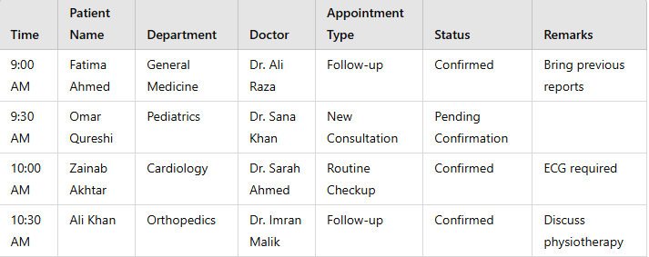
APPOINTMENT SCHEDULING
Book your appointment online to receive personalized care without long wait times. Visit our website to schedule today.

Slide 19
TECHNOLOGY IN HEALTHCARE
Implementing AI diagnostics, telemedicine, and advanced medical equipment to enhance patient outcomes.

Slide 20
COMMUNITY ENGAGEMENT
Supporting local communities through:
Food and supply delivery
Emotional assistance during crises

Slide 21
THANK YOU
We look forward to serving your healthcare needs!

